Slide 1
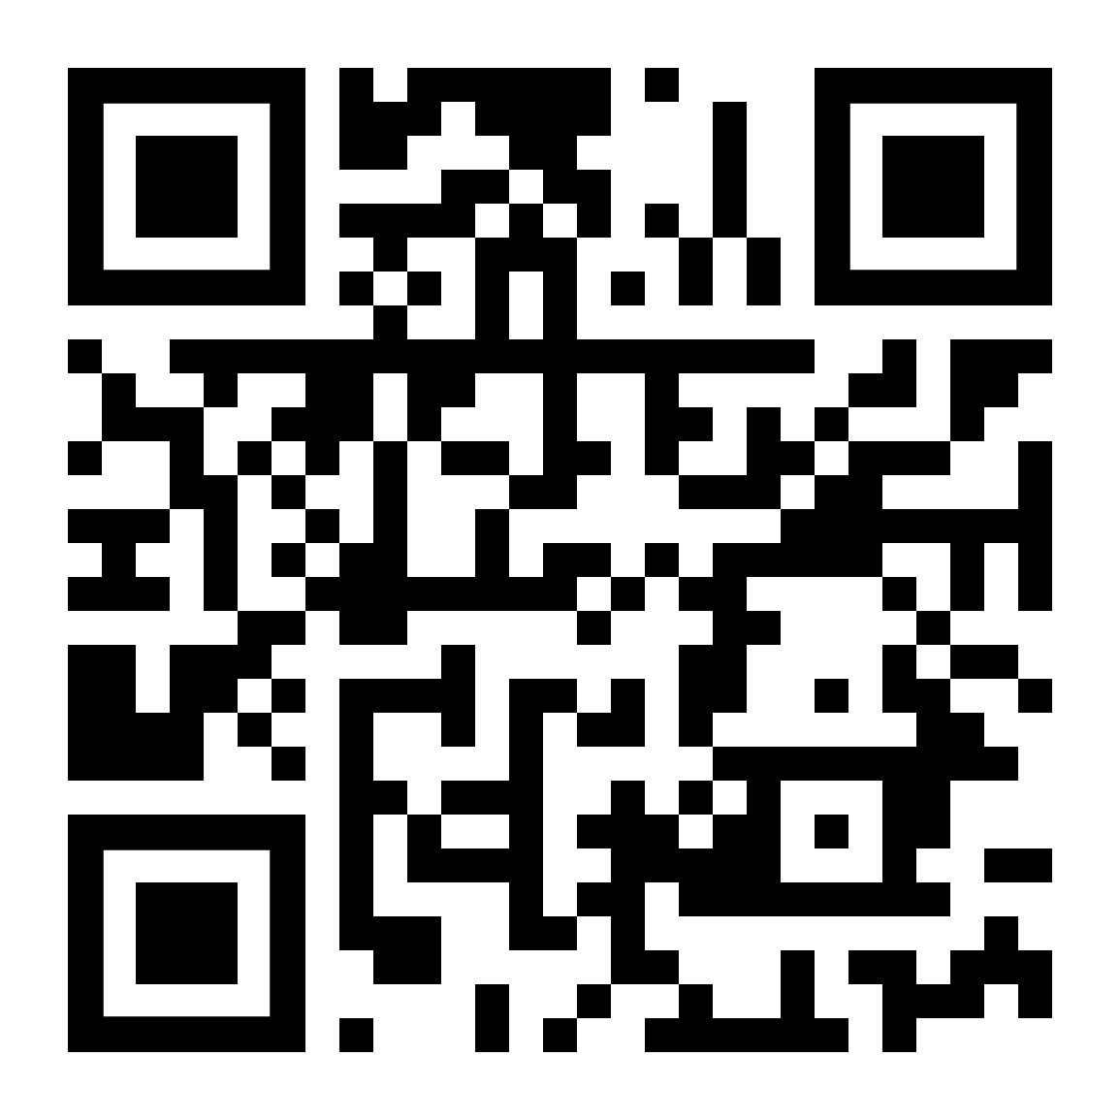


TouchDesigner Beginners Workshop
WIFI: ccu
WW: Code03084
https://discord.gg/dWyuS96jD6

Slide 2
Next Up: TouchDesigner Workshop Advanced 23rd TouchDesigner Meetup April 25th

Slide 3
www.creativecodingutrecht.nl

